Slide 1

Skills for Success with Microsoft Office 2016 Volume 1
by Margo Chaney Adkins, Catherine Hain, Lisa Hawkins, and Stephanie Murre Wolf
Excel Chapter 1
Create Workbooks with Excel 2016
Notes:
Skills for Success with Microsoft Office 2016 Volume 1

Slide 2
Skills
Create and Save Workbooks
Enter Data and Merge and Center Titles
Construct Addition and Subtraction Formulas
Construct Multiplication and Division Formulas
Adjust Column Widths and Apply Cell Styles
Notes:
The skills of this chapter are:
Create and Save Workbooks
Enter Data and Merge and Center Titles
Construct Addition and Subtraction Formulas
Construct Multiplication and Division Formulas
Adjust Column Widths and Apply Cell Styles
The skills continue on the next slide.

Slide 3
Skills (cont.)
Insert the SUM function
AutoFill Formulas and Data
Format, Edit, and Check Spelling
Insert Footers and Adjust Page Settings
Display Formulas and Print Worksheets
Notes:
The skills of this chapter are:
Insert the SUM function
AutoFill Formulas and Data
Format, Edit, and Check Spelling
Insert Footers and Adjust Page Settings
Display Formulas and Print Worksheets

Slide 4
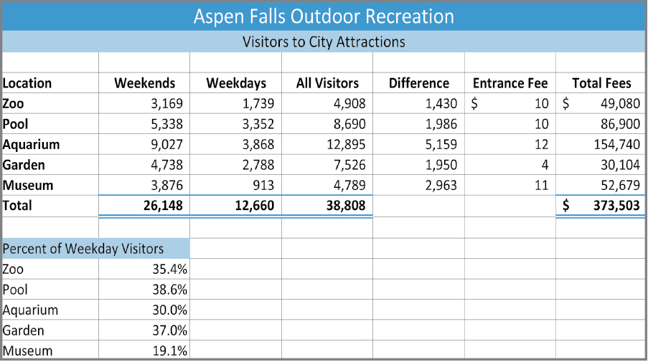

Introduction
Notes:
Once you go through the skills in this chapter, you will be able to create spreadsheets like the one shown here.

Slide 5
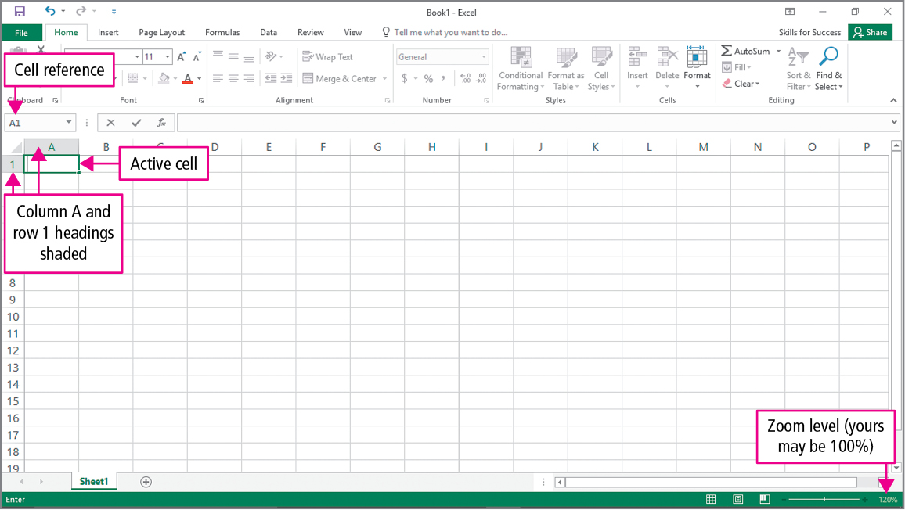
Skill 1: Create and Save Workbooks
Notes:
Excel is a program that allows you to create workbooks. A workbook is used to organize various kinds of related information. A workbook is made up of one or more worksheets or spreadsheets. A worksheet is made up of cells. A cell is where a row and a column intersect in the worksheet. The active cell is where data is entered into the worksheet.

Slide 6
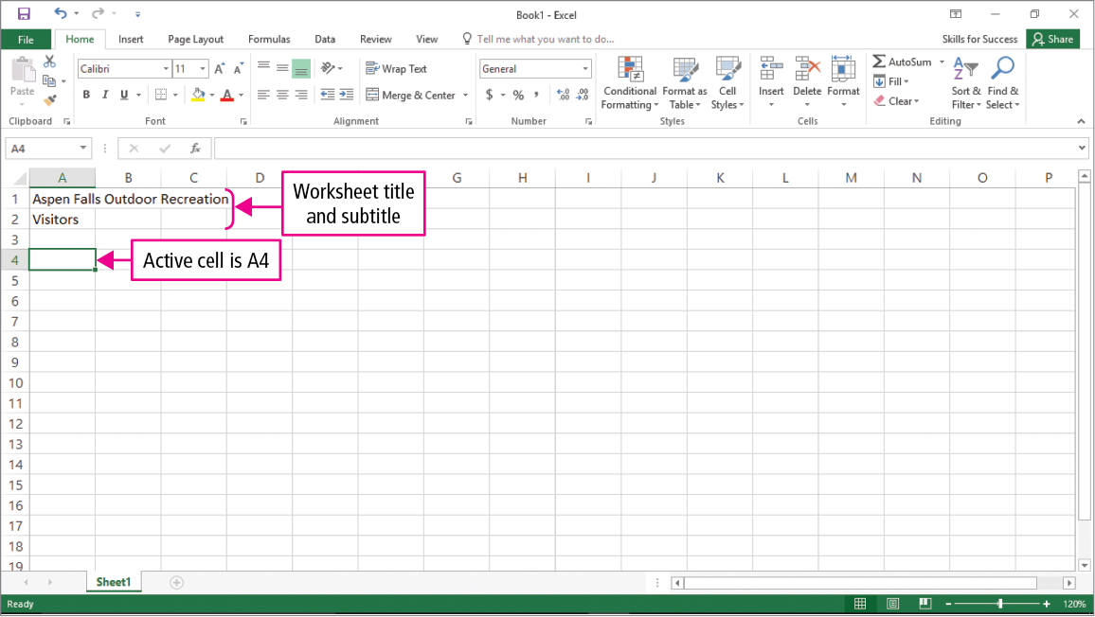
Skill 1: Create and Save Workbooks (cont.)
Notes:
Cells are identified by what row and what column they are located in. The column letter and row number that a cell is found in makes up that cell address or cell reference. The active cell is the cell that is outlined in green in which data is entered when you begin typing.

Slide 7
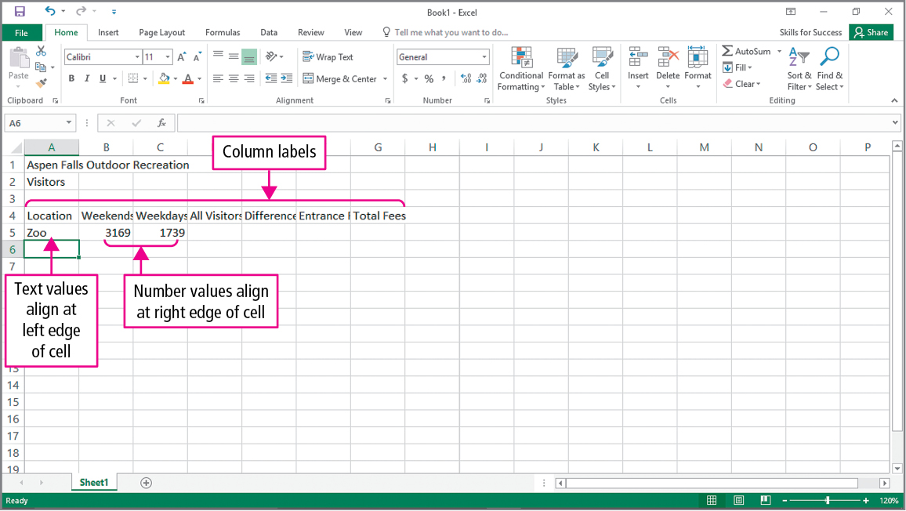
Skill 1: Create and Save Workbooks (cont.)
Notes:
Each piece of data placed in a cell is called a value. Number values represent data that will be used in calculations and is aligned to the right edge to the cell. Text values are used to label the numeric data and are aligned to the left edge of the cell. Many times a text value is used a label.

Slide 8
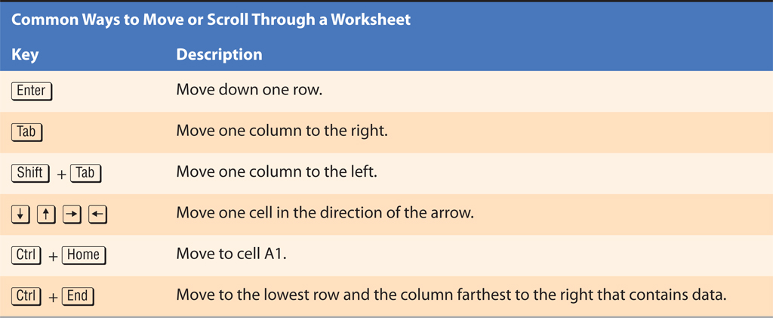
Skill 1: Create and Save Workbooks (cont.)
Notes:
Several common ways to move or scroll through a worksheet are listed on this slide.
Pressing the Enter key will move you down one row. Pressing the Tab key will move you one column to the right. Pressing the Shift key and the Tab key at the same time will move you one column to the left. The arrow keys move the cursor one cell in the direction of the arrow. To move to cell A1 from anywhere in the worksheet you can press the Ctrl and the Home keys at the same time. Pressing the Ctrl key and the End key at the same time will take you to the lowest row and farthest column to the right that contains data.

Slide 9
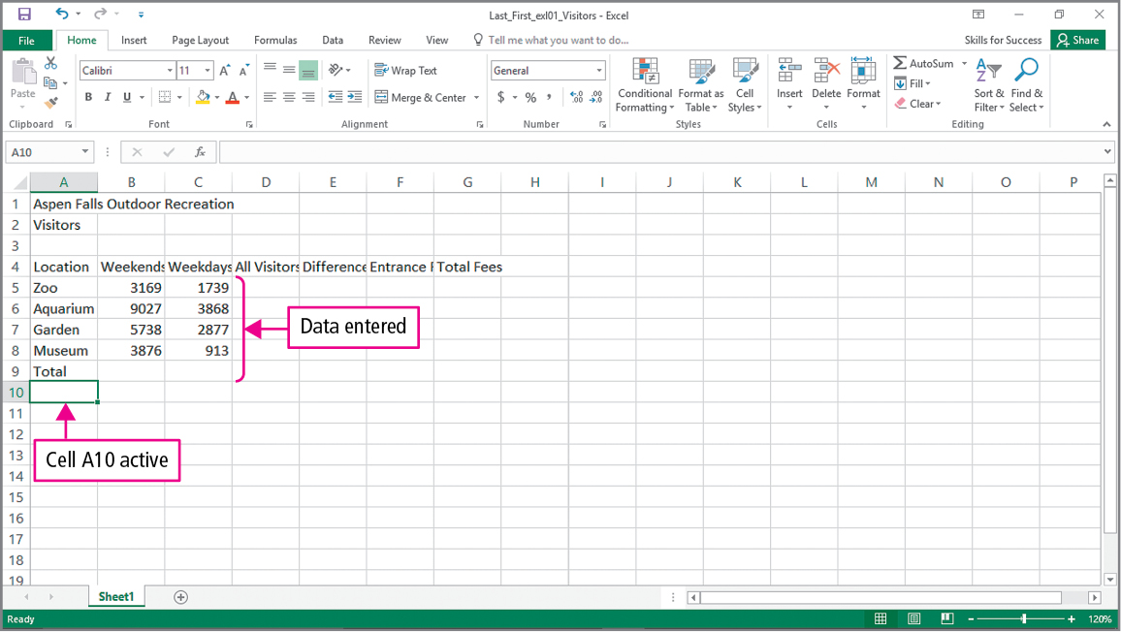
Skill 2: Enter Data and Merge and Center Titles
Notes:
Titles and subtitles make your workbook more effective.
Notice that the data entered into cell A1 are wider than the cell. It still displays because cells B1 and C1 are empty.

Slide 10
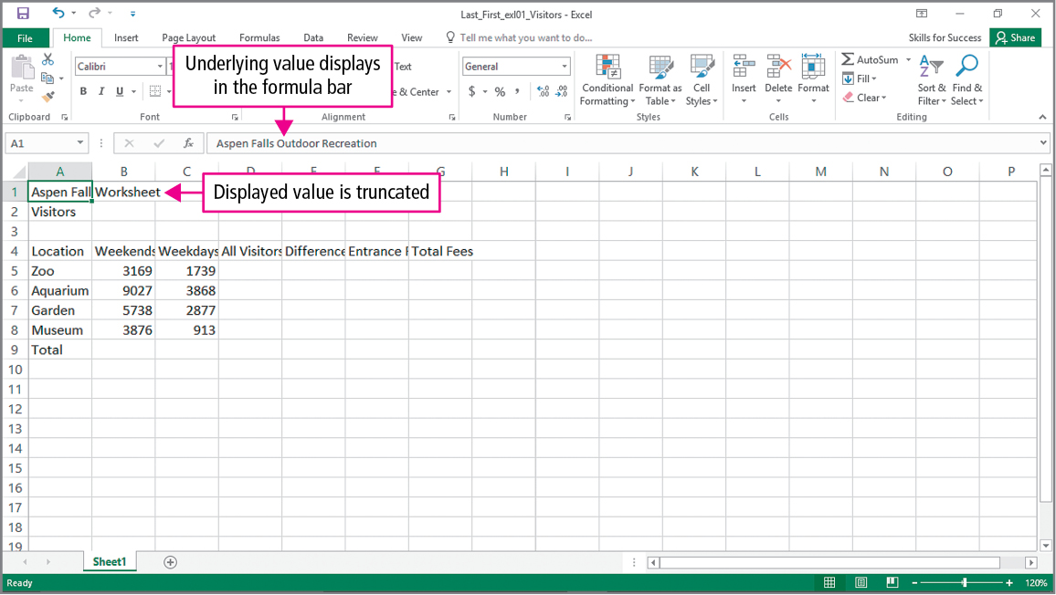
Skill 2: Enter Data and Merge and Center Titles (cont.)
Notes:
Once a value is entered into cell B1, the value in cell A1 is truncated—cut off. You can see what is actually in cell A1 by making it the active cell and seeing what is displayed in the formula bar.
The formula bar is a bar below the ribbon that displays the value contained in the active cell and is used to enter or edit values or formulas.
Data displayed in a cell is the displayed value. Data displayed in the formula bar is the underlying value. These two values do not always match.

Slide 11
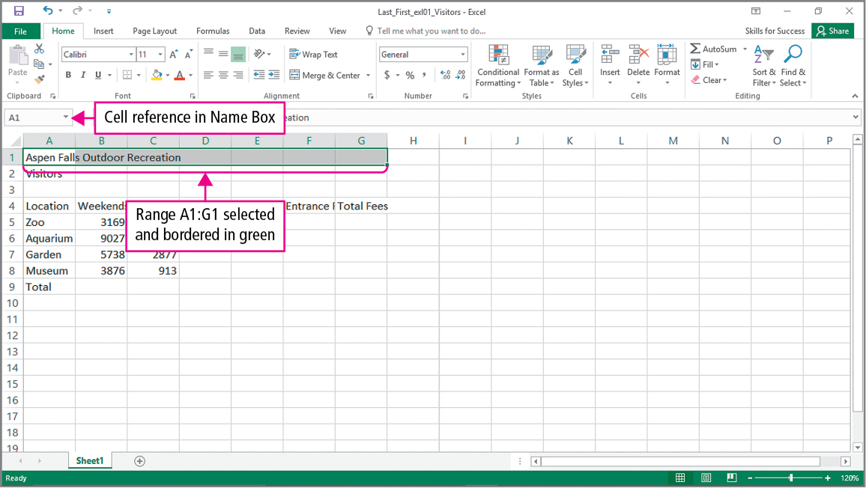
Skill 2: Enter Data and Merge and Center Titles (cont.)
Notes:
A range is two or more adjacent cells. Formatting can be applied to all the cells in a range at one time.
The Name Box is an area of the formula bar that displays the active cell reference - that is, it displays the address of the active cell.

Slide 12
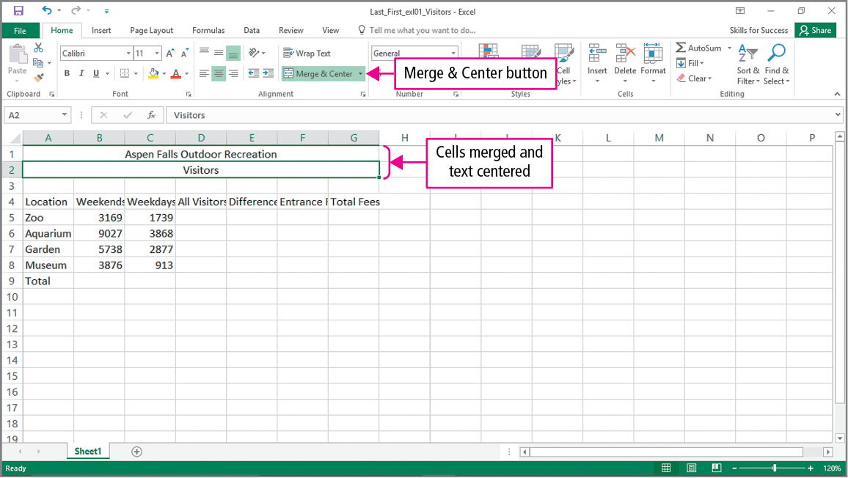
Skill 2: Enter Data and Merge and Center Titles (cont.)
Notes:
Once you select a range of cells and apply the Merge & Center button, the cells of the range are merged into one cell. Once the cells are merged, they can no longer be selected as the active cell individually.

Slide 13
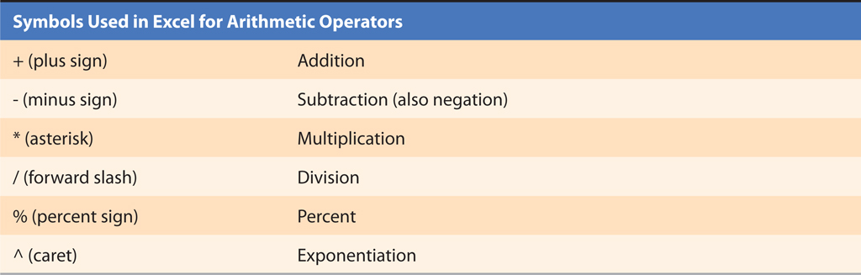
Skill 3: Construct Addition and Subtraction Formulas
Notes:
A formula is an equation that carries out mathematical calculations. Formulas always begin with an equal sign.
Arithmetic operators can be used when creating formulas in Excel.
When constructing formulas in Excel, the + is used to indicate addition, the minus sign indicates subtraction, the asterisk is used to indicate multiplication, the forward slash is used for division, the percentage sign is used to calculate percent, and the caret is used for exponentiation—raising a number to a power.

Slide 14
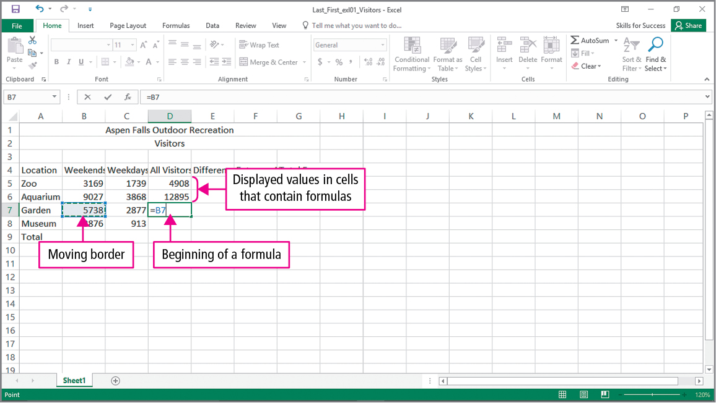
Skill 3: Construct Addition and Subtraction Formulas (cont.)
Notes:
Excel’s Formula AutoComplete will suggest values as you type a function. Remember that all formulas must start with an equal sign. When a cell is surrounded by a moving border, it means the cell is part of a function. Formulas can be entered by typing or by pointing and clicking. After a formula is entered, the result of the formula will display in the worksheet. The formula will appear in the formula bar when the cell is active.

Slide 15
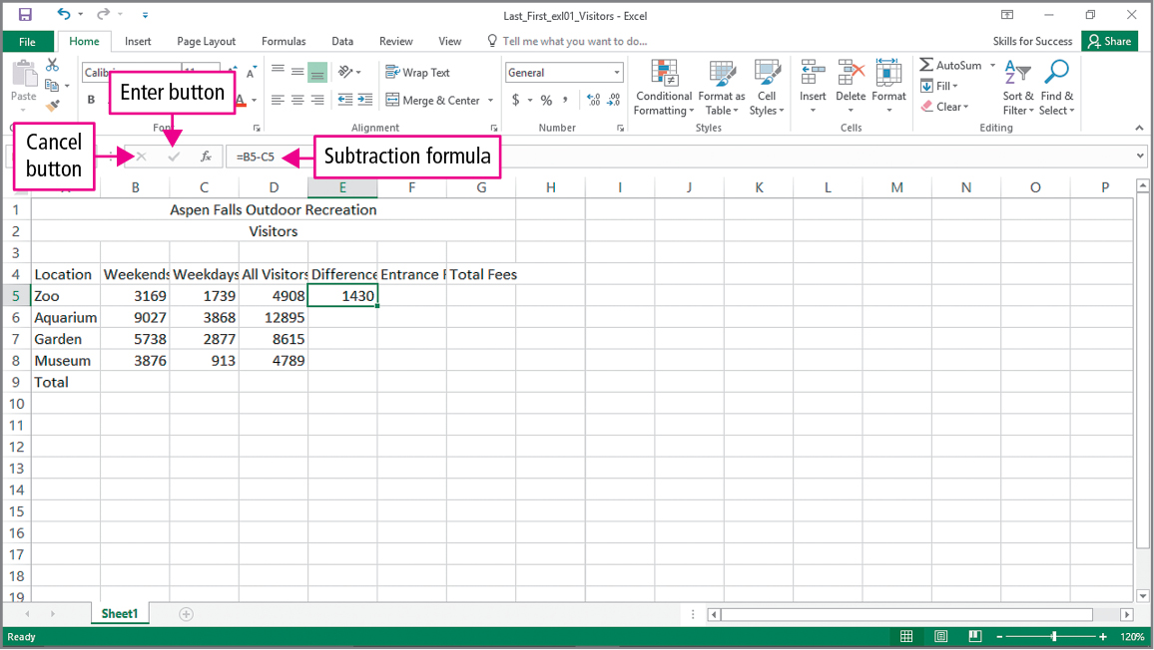
Skill 3: Construct Addition and Subtraction Formulas (cont.)
Notes:
Once you have entered a formula, you can click on the check mark on the Formula Bar to confirm and keep the current cell the active cell. If you make a mistake while entering a formula you can press the Esc key or click the Cancel button.

Slide 16
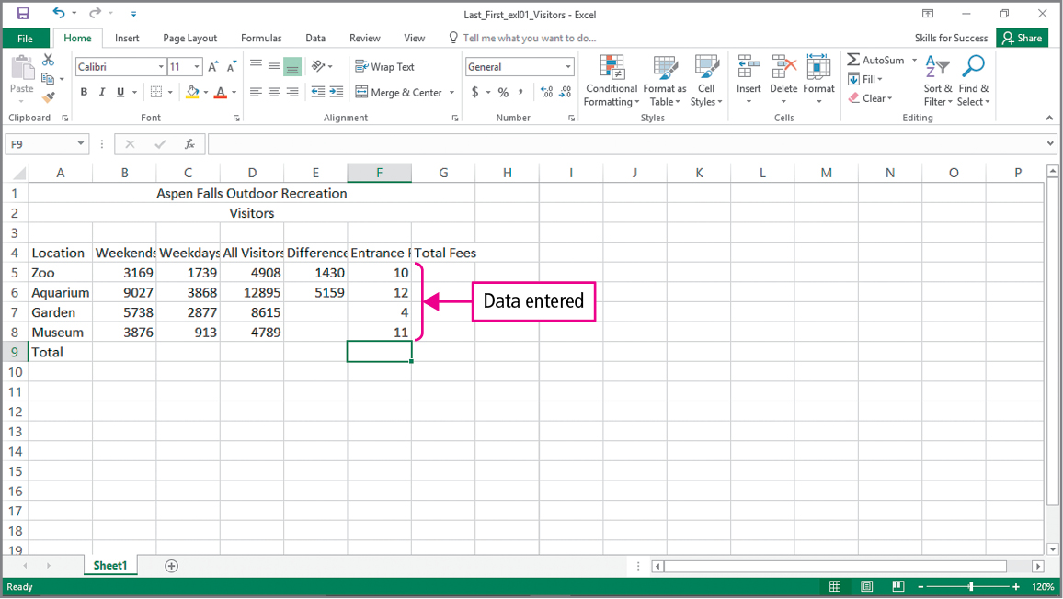
Skill 3: Construct Addition and Subtraction Formulas (cont.)
Notes:
As you enter data into column F, you can press the down arrow key after you enter each number to be moved to the row below.

Slide 17
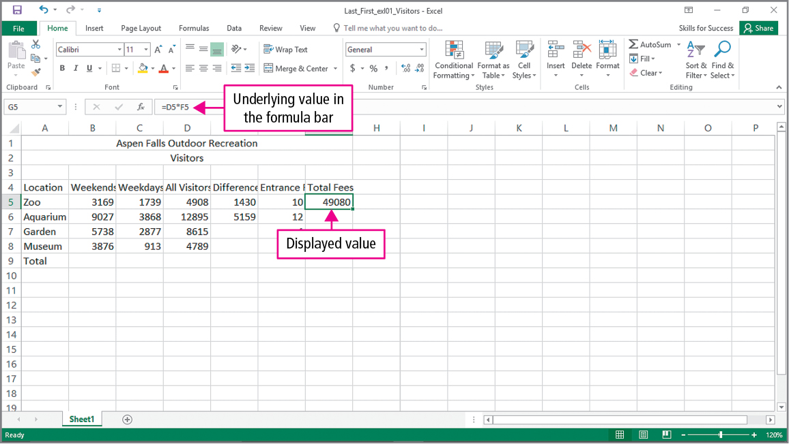
Skill 4: Construct Multiplication and Division Formulas
Notes:
A cell that contains a formula will show the displayed value, the value produced by the formula, in the worksheet. The actual formula or underlying formula will be displayed in the formula bar.

Slide 18
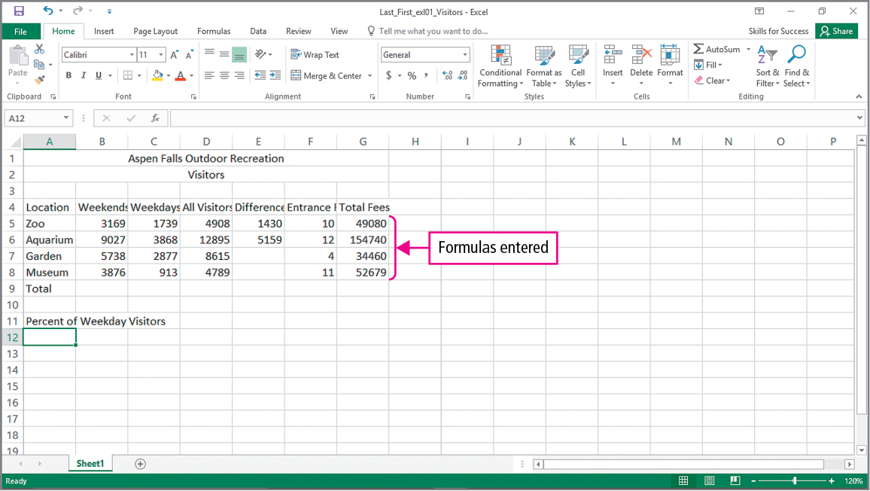
Skill 4: Construct Multiplication and Division Formulas (cont.)
Notes:
The values shown in column G are the result of the formulas that have been entered in that column.

Slide 19
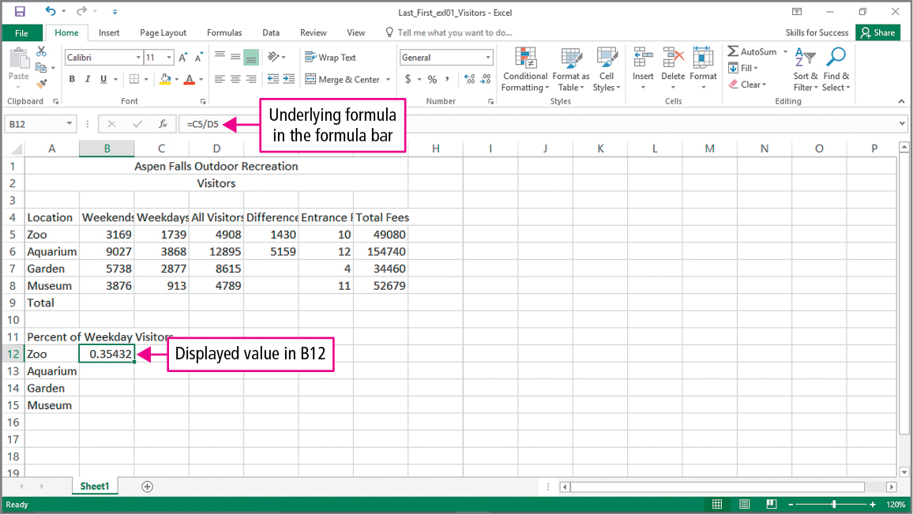
Skill 4: Construct Multiplication and Division Formulas (cont.)
Notes:
The formula bar is displaying the underlying formula of cell B12. Notice that the / symbol is being used to indicate division. The workbook is showing the result of the formula in cell B12.

Slide 20
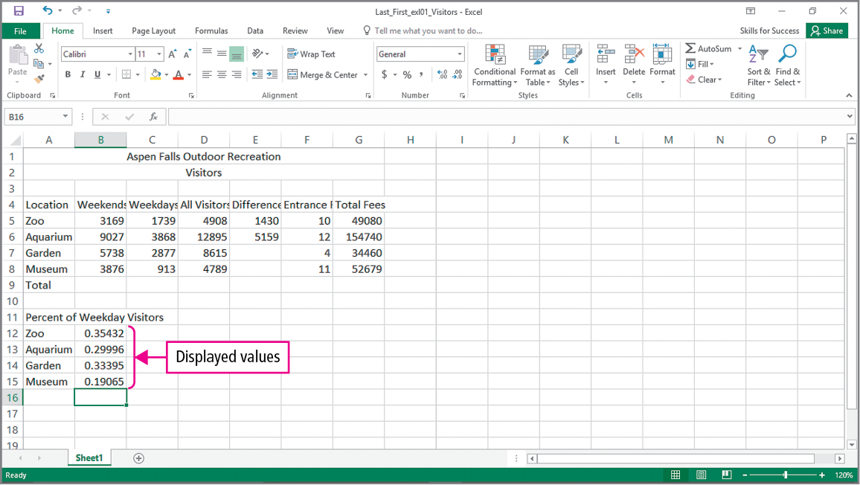
Skill 4: Construct Multiplication and Division Formulas (cont.)
Notes:
The displayed values shown in cells B12, B13, B14, and B15 are the results of the division formulas placed into those cells.

Slide 21
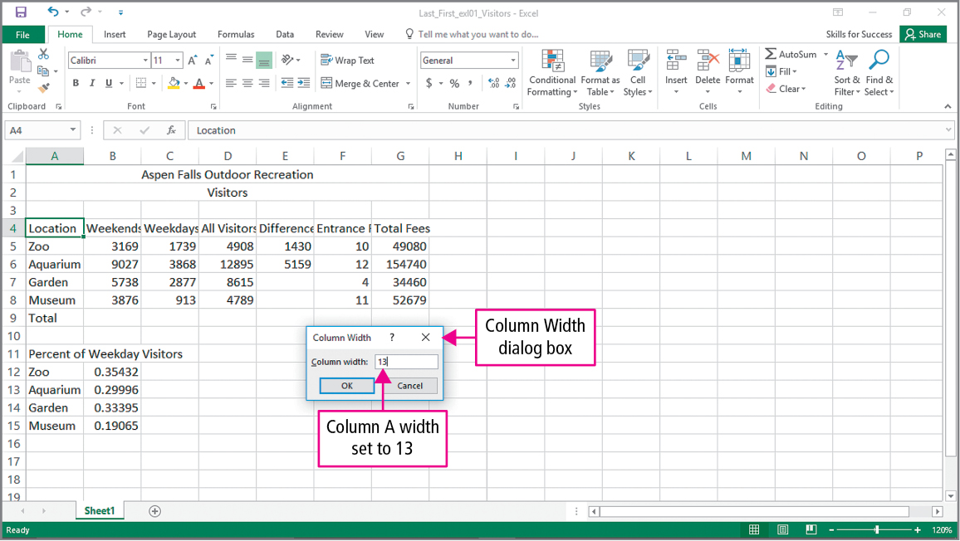
Skill 5: Adjust Column Widths and Apply Cell Styles
Notes:
Formatting is the process of specifying the layout or appearance of cells or the worksheet. Column Headings are the letters that appear at the top of the columns in the workbook. Row Headings are the numbers that appear to the left of the rows in the worksheet.
The Column Width dialog box allows you to indicate how wide you want a column to be.

Slide 22
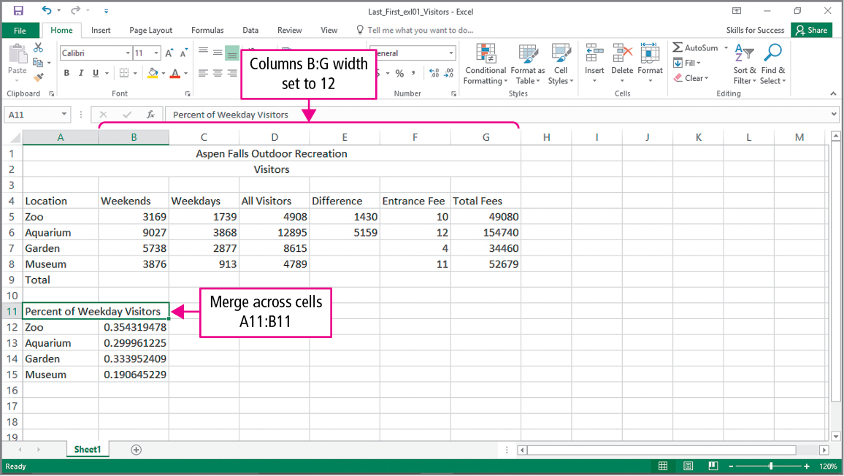
Skill 5: Adjust Column Widths and Apply Cell Styles (cont.)
Notes:
Notice that columns B through G are now wider. This is the result of using the Column Width dialog box in the previous slide.

Slide 23
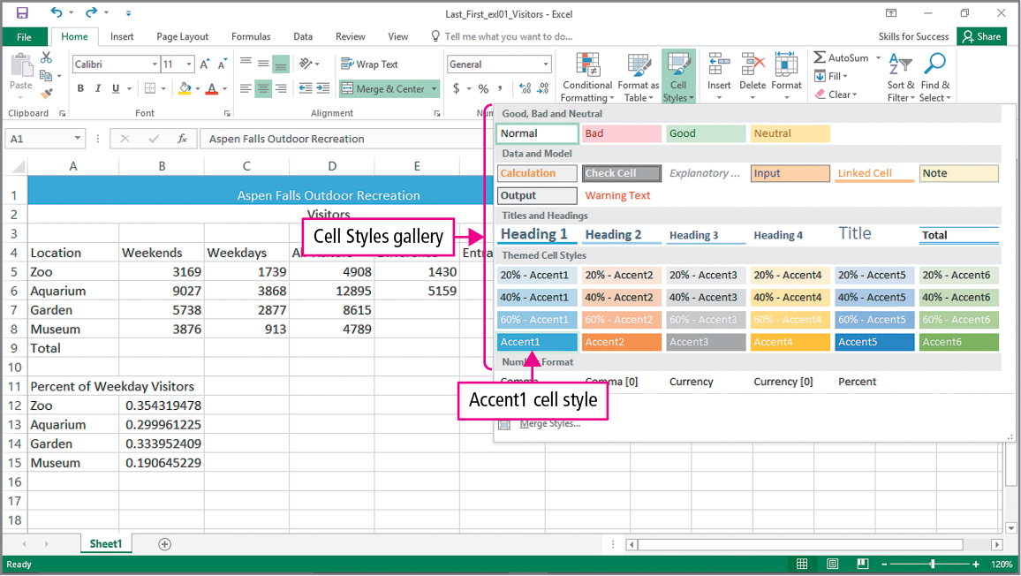
Skill 5: Adjust Column Widths and Apply Cell Styles (cont.)
Notes:
Cell styles are pre-built sets of formatting characteristics. These characteristics may include font, font size, font color, cell borders, and cell shading.

Slide 24
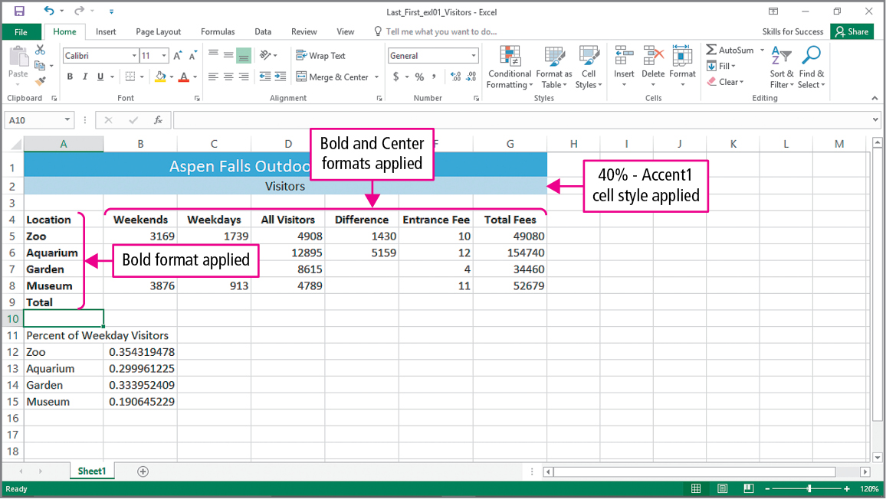
Skill 5: Adjust Column Widths and Apply Cell Styles (cont.)
Notes:
This slide shows the effects of applying the Accent1 cell style, bold formatting, and bold and center formatting.

Slide 25
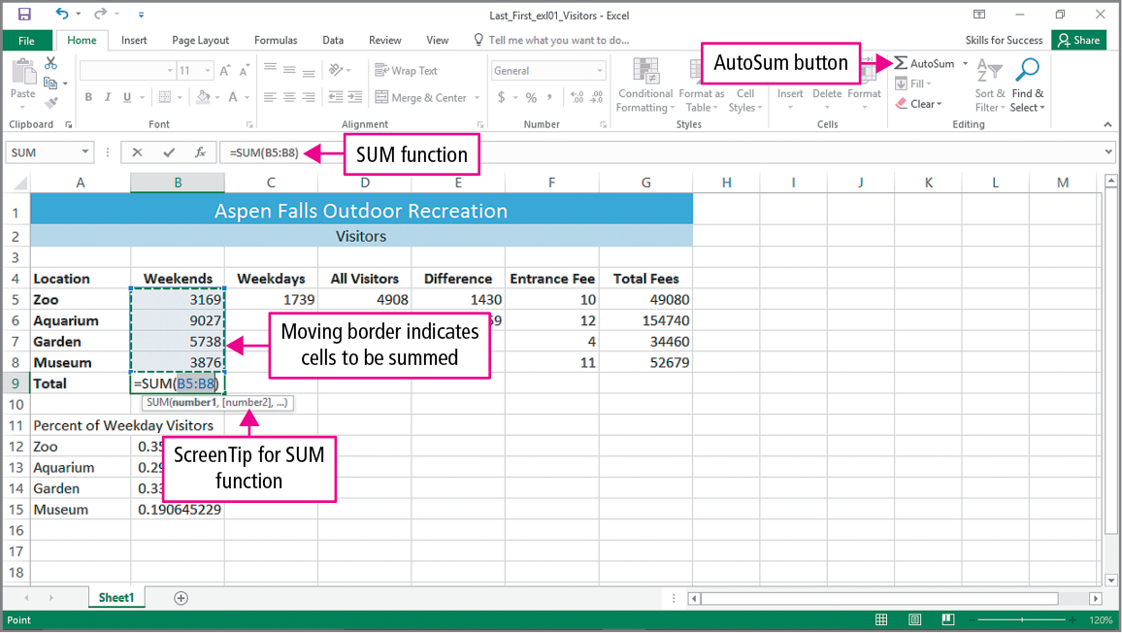
Skill 6: Insert the SUM Function
Notes:
An Excel function is a prewritten formula that takes values, performs operations, and returns a value. The AutoSum button can be used to enter the SUM function into a cell. The SUM function adds all values in a range. When data in a cell changes, all formulas and functions that reference that cell are recalculated.

Slide 26
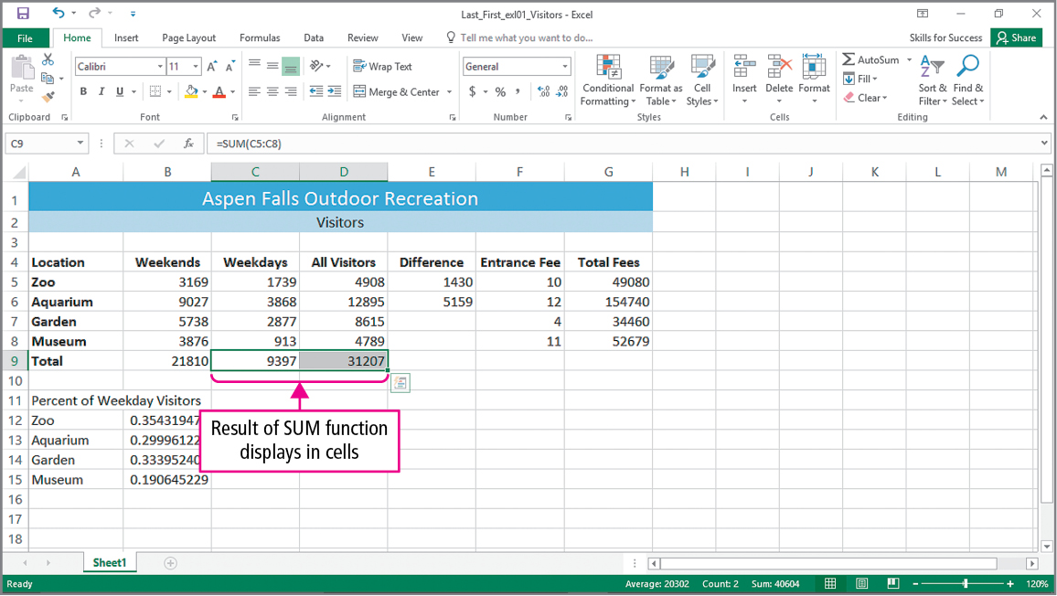
Skill 6: Insert the SUM Function (cont.)
Notes:
Cells C9 and D9 show the result of using the SUM function.

Slide 27
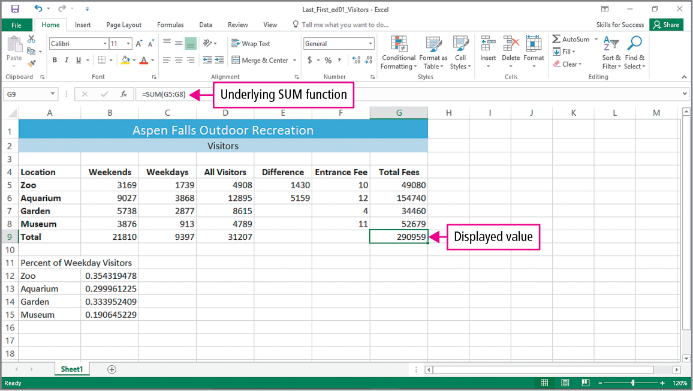
Skill 6: Insert the SUM Function (cont.)
Notes:
On this slide, you can see that the underlying SUM function placed in cell G9 calculated the value actually shown on cell G9.

Slide 28
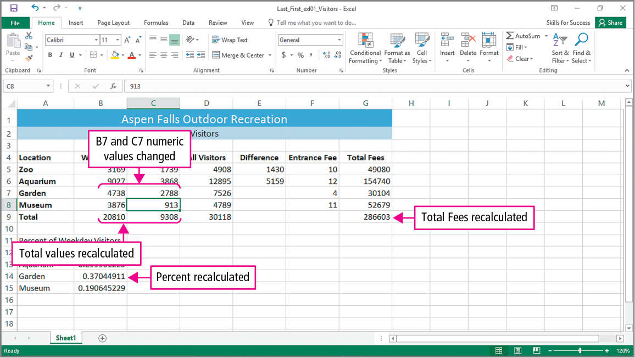
Skill 6: Insert the SUM Function (cont.)
Notes:
Remember, whenever a value in a cell is changed, all formulas or functions that use that value will be recalculated. This is a very powerful feature of Excel.

Slide 29
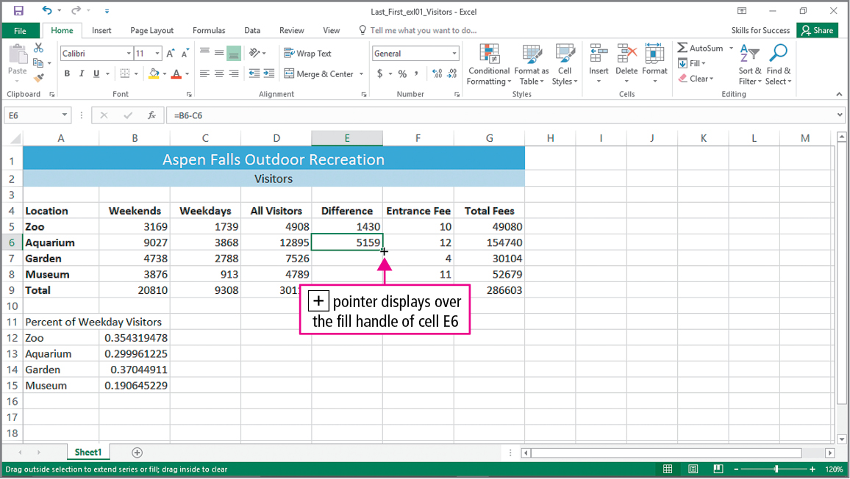
Skill 7: AutoFill Formulas and Data
Notes:
Text, numbers, formulas, and functions can be copied from one cell to another. When a formula or function is copied, the cell references are updated relative to the new location of the formula or function.
The fill handle can be used to drag items to adjacent cells.

Slide 30
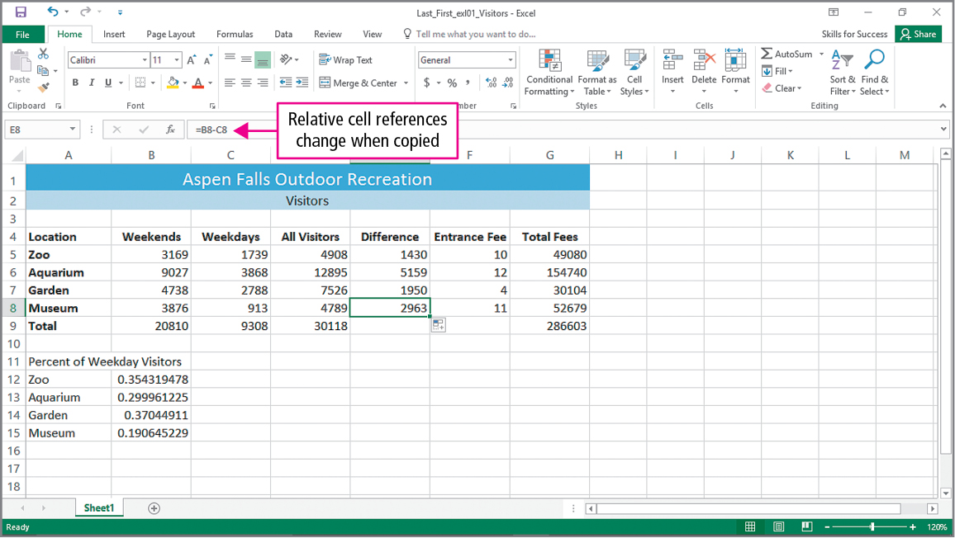
Skill 7: AutoFill Formulas and Data (cont.)
Notes:
A relative cell reference refers to cells based on their position in relation to the cell that contains the formula.

Slide 31
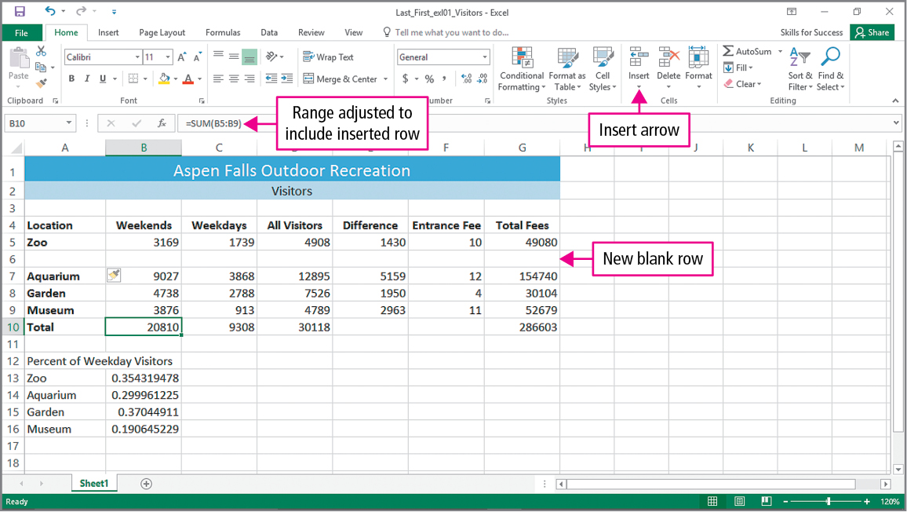
Skill 7: AutoFill Formulas and Data (cont.)
Notes:
When new rows or columns are added to the worksheet, all relative cell references are updated.

Slide 32
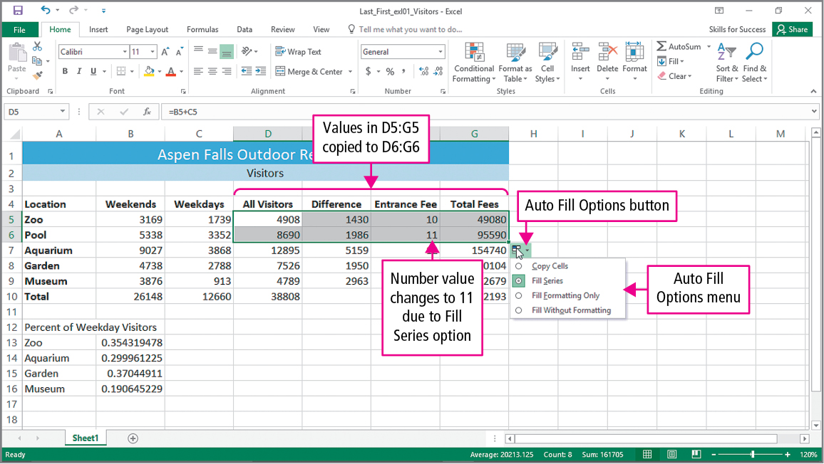
Skill 7: AutoFill Formulas and Data (cont.)
Notes:
When you use Auto Fill to copy numbers, they are incremented. Notice that the value in cell F5 was incremented when it was copied using Auto Fill to cell F6.

Slide 33
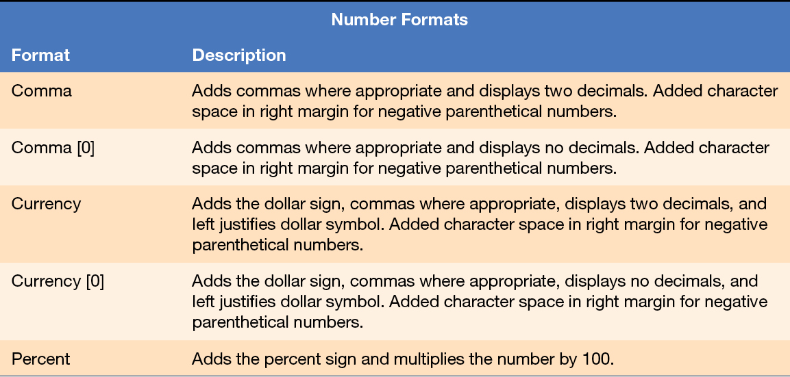
Skill 8: Format, Edit, and Check Spelling
Notes:
The table on this slide shows some common Number Formats used in Excel.

Slide 34
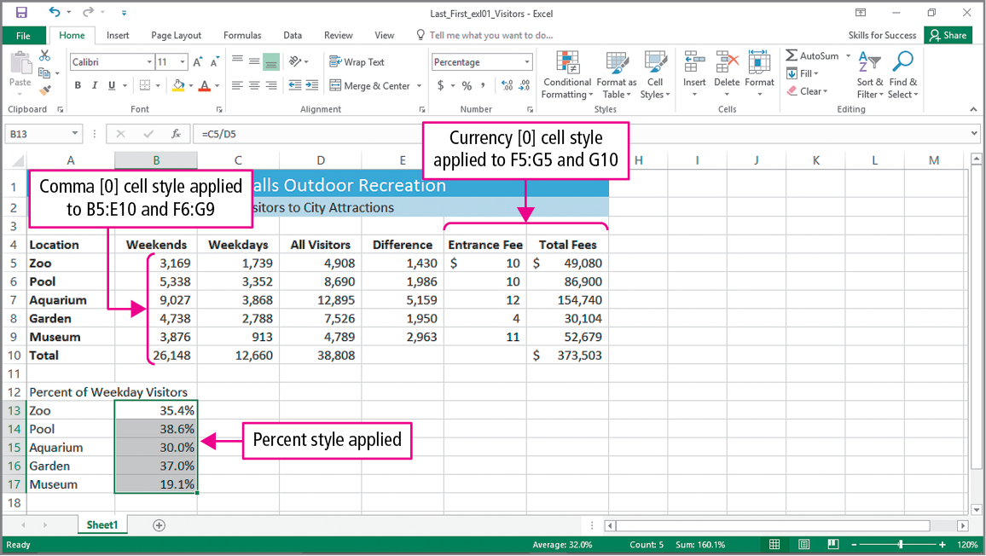
Skill 8: Format, Edit, and Check Spelling (cont.)
Notes:
This slide shows the result of using certain cell styles. The items that have had Currency zero cell style applied to them show dollars signs, commas where appropriate, and no decimals. The items that have had the Comma zero cell style applied show commas where appropriate and no decimals. The cells where the Percent style has been applied show a percent sign and the numbers have been multiplied by 100.

Slide 35
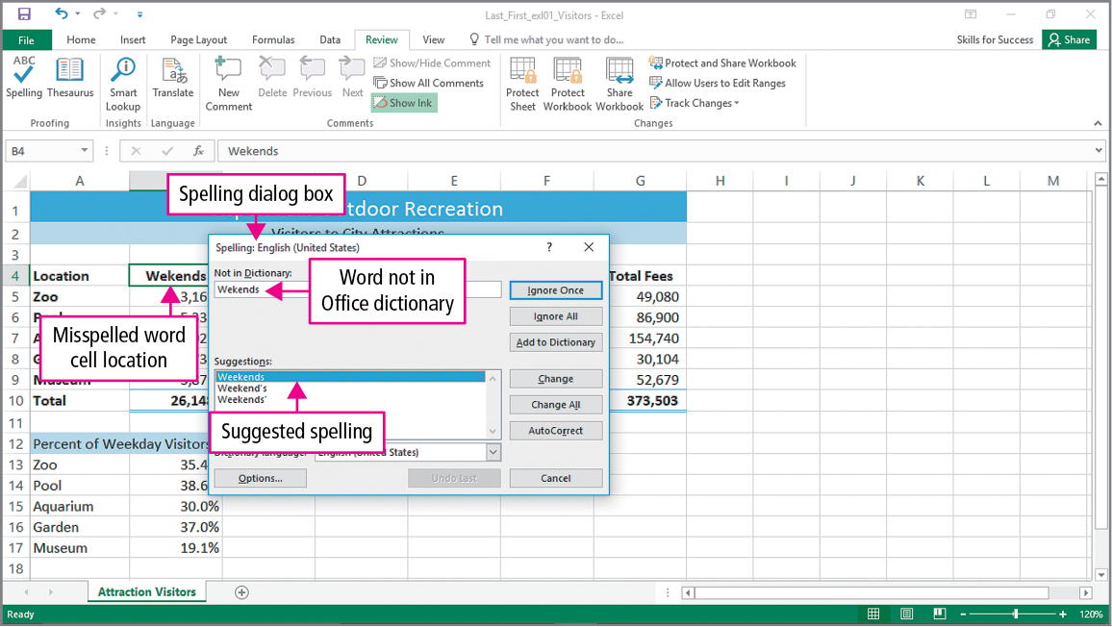
Skill 8: Format, Edit, and Check Spelling (cont.)
Notes:
It is a good idea to make cell A1 the active cell before you check spelling in your worksheet. This is because the spell checker works to the right and down. Making cell A1 the active cell will guarantee that the entire worksheet will be checked. Not all words that are indicated as being misspelled by the spell checker will be misspelled. The spell checker may indicate that correctly spelled proper nouns are incorrectly spelled. When spell check does find a word that is not in its dictionary, it will provide suggested words.

Slide 36
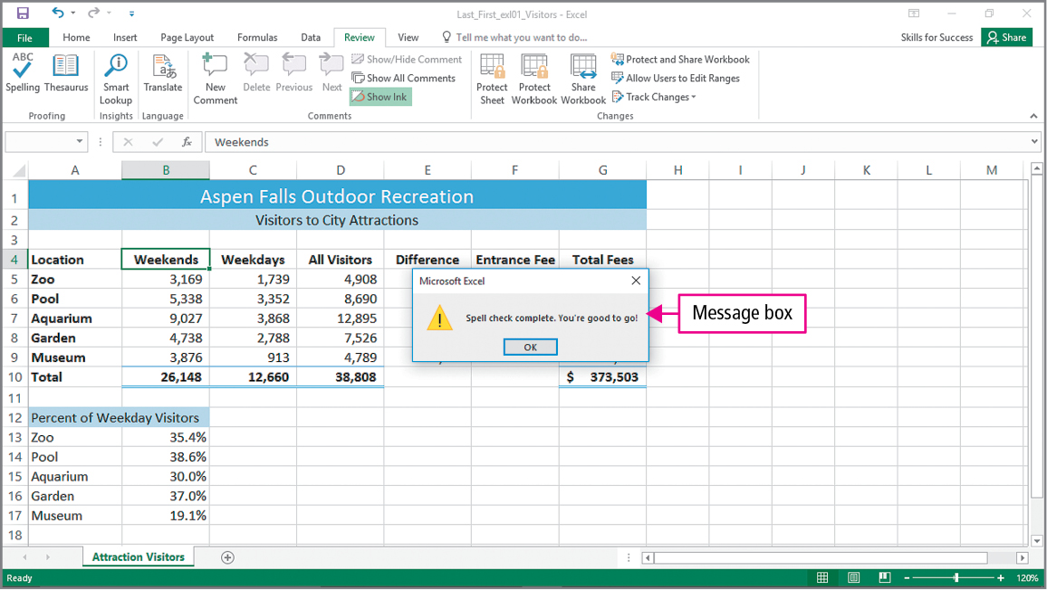
Skill 8: Format, Edit, and Check Spelling (cont.)
Notes:
The Spell check complete. You’re good to go! message tells you that the spell check is complete. If there are words that you use often that are not in the Office dictionary, you can click Add to Dictionary to add them.

Slide 37
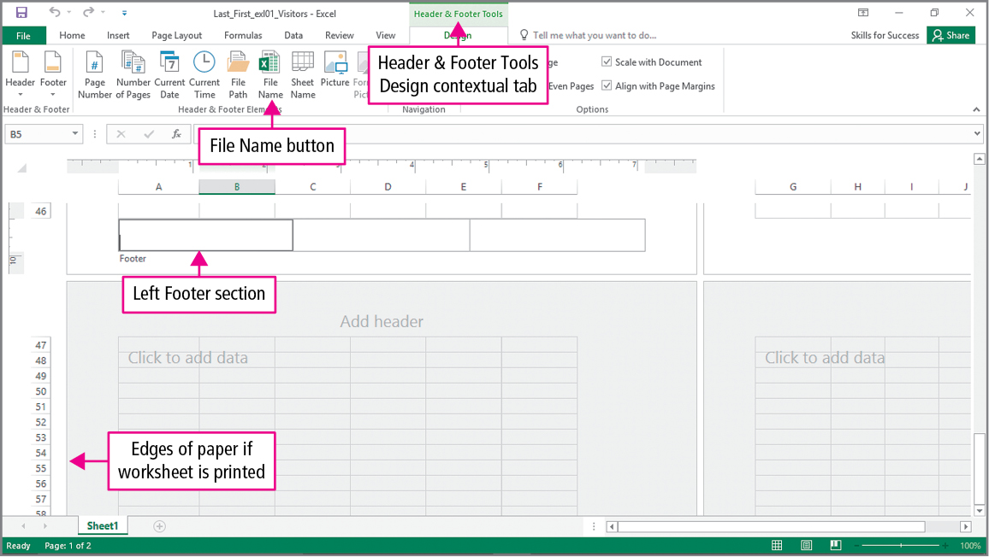
Skill 9: Insert Footers and Adjust Page Settings
Notes:
Excel’s Page Layout view is used to adjust how a worksheet will look when printed. This view allows you to add headers and footers to your worksheet.

Slide 38
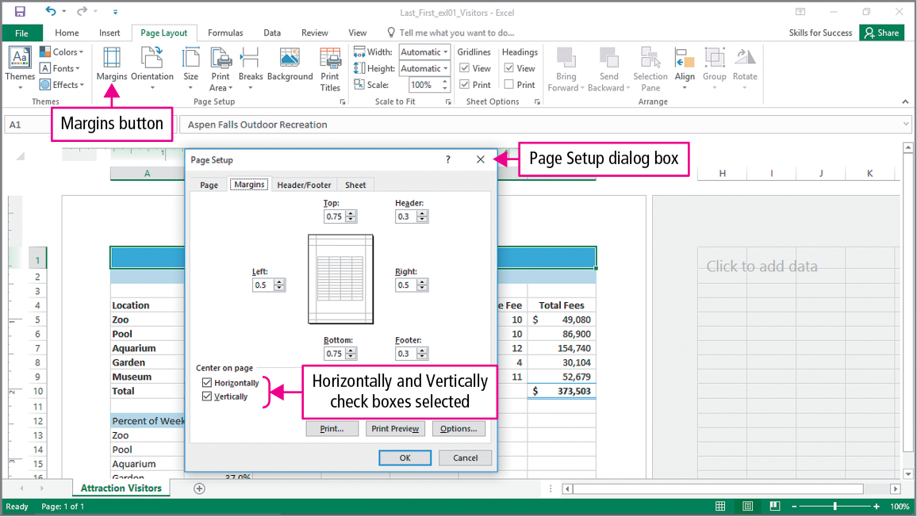
Skill 9: Insert Footers and Adjust Page Settings (cont.)
Notes:
The Page Setup dialog box allows you to adjust margins and center the worksheet on the printed page

Slide 39
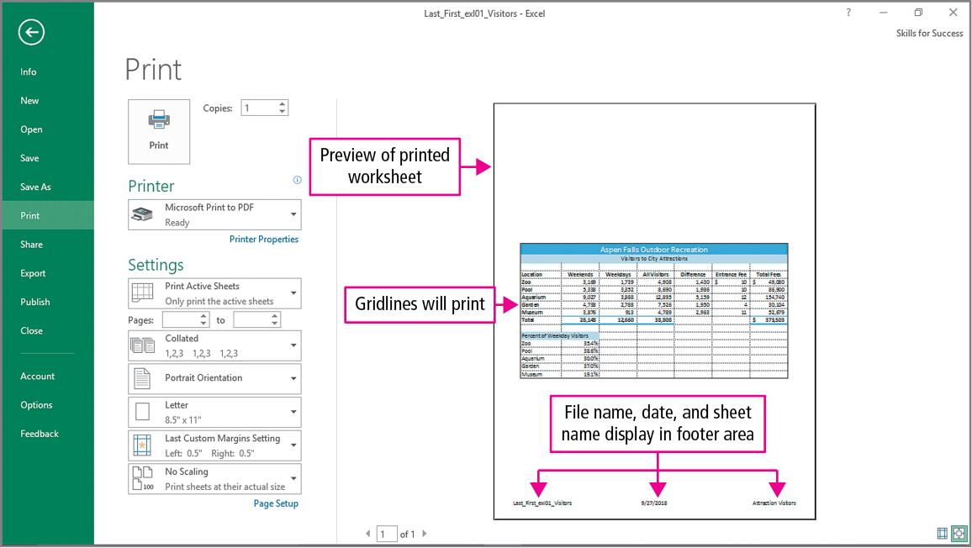
Skill 9: Insert Footers and Adjust Page Settings (cont.)
Notes:
Normal view maximizes the number of cells visible on the screen. The dotted line between columns G and H indicate where one page ends and another page begins.

Slide 40
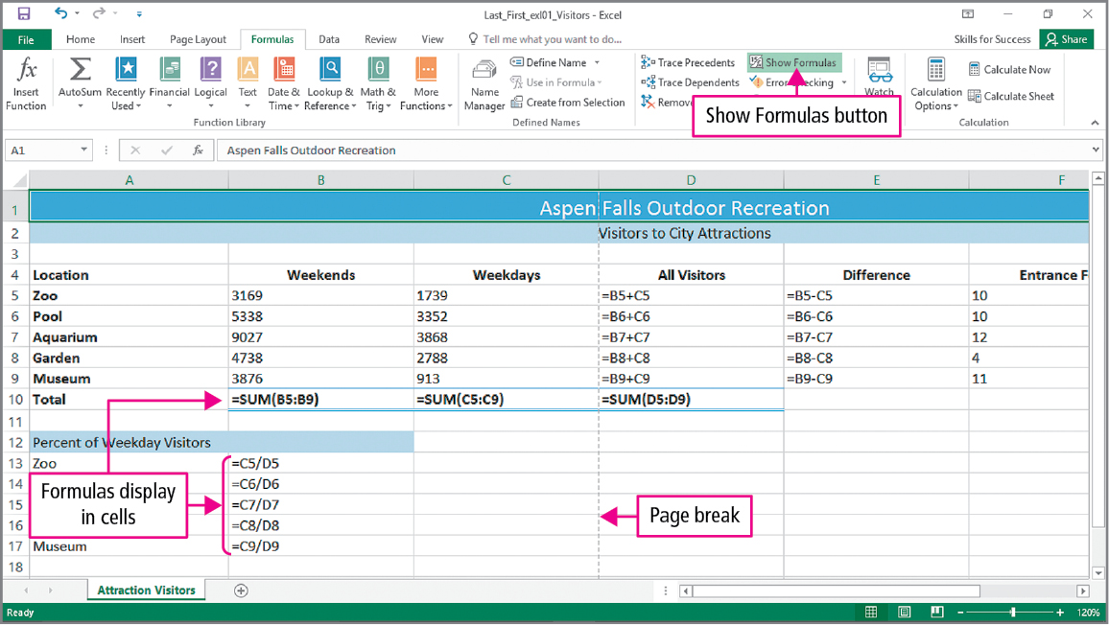
Skill 10: Display Formulas and Print Worksheets
Notes:
Underlying formulas and functions can be printed if needed. When displaying underlying formulas and functions, you may want to change the scale and the orientation of the worksheet so it displays on a single page.

Slide 41
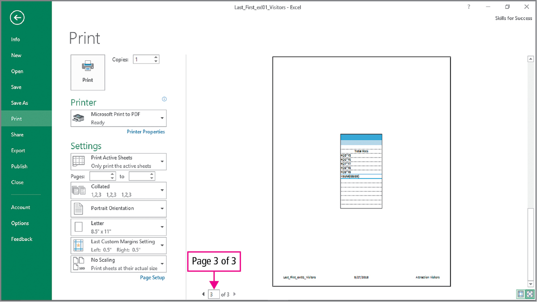
Skill 10: Display Formulas and Print Worksheets (cont.)
Notes:
Using the Backstage view and the Next Page button twice should display the image shown on this screen.

Slide 42
Skill 10: Display Formulas and Print Worksheets (cont.)
Notes:
When scaling the worksheet, you can specify how many pages you want it to be printed on.

Slide 43
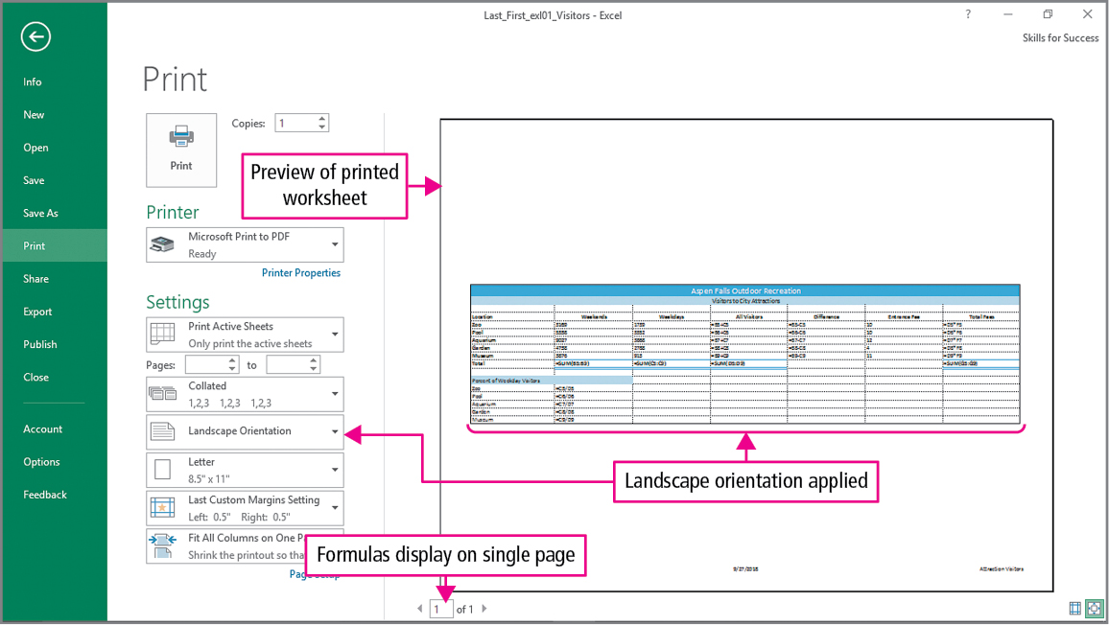
Skill 10: Display Formulas and Print Worksheets (cont.)
Notes:
This slide shows that the worksheet will be printed on a single page and that it will be printed using landscape orientation.

Slide 44
More Skills For Success
You will now practice the following additional skills:
Set Print Areas
Fill Data with Flash Fill
Create Templates and Workbooks from Templates
Manage Document Properties
Notes:
The More Skills for Success in this chapter will show you how to:
Set Print Areas
Fill Data with Flash Fill
Create Templates and Workbooks from Templates
Manage Document Properties

Slide 45
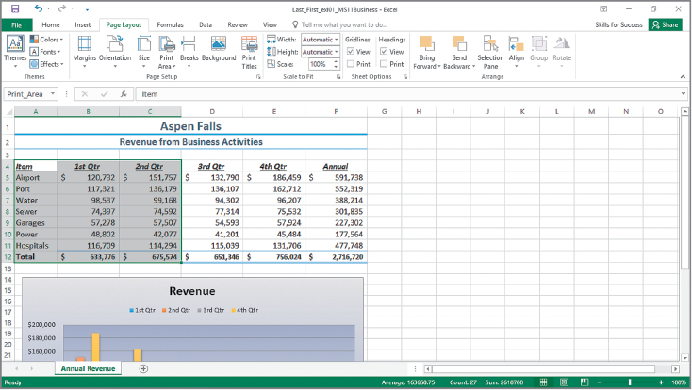
More Skills 11: Set Print Areas
Notes:
If the same portion of a worksheet needs to be printed repeatedly, you can save time by setting a print area. When a print area is set, the range of the selected cells is named Print_Area, as shown in the Name box.

Slide 46
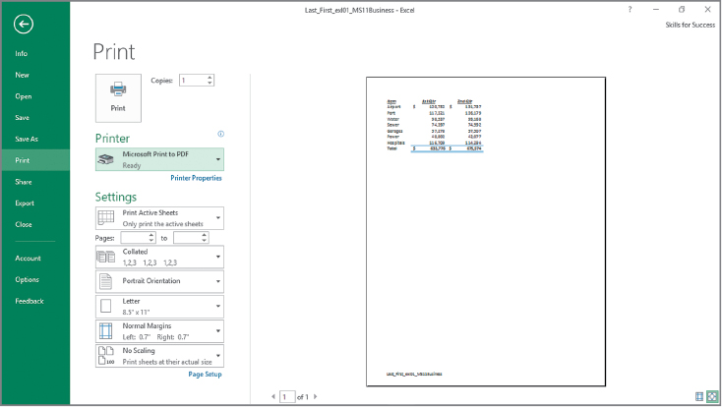
More Skills 11: Set Print Area (cont.)
Notes:
To print a worksheet portion only once, select the cells, and then on the File tab, click Print. Under settings, select Print Selection.

Slide 47
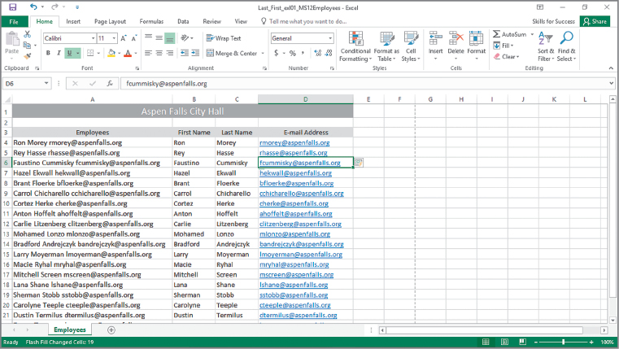
More Skills 12: Fill Data with Flash Fill
Notes:
Flash Fill recognizes a pattern in data and automatically enters the rest of the data. When there is a space between data in a cell, you can separate the data into separate columns by using Flash Fill.

Slide 48
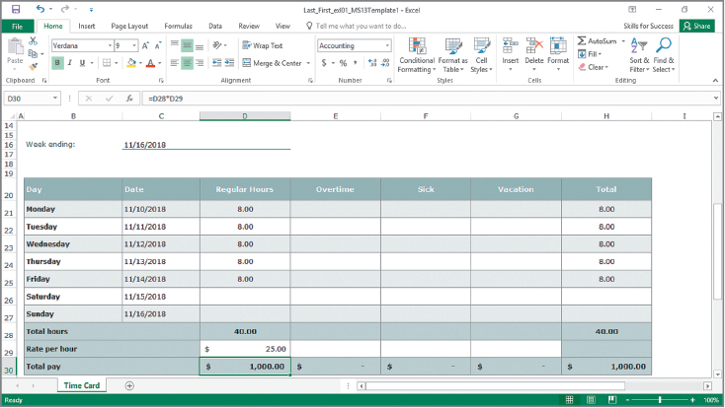
More Skills 13: Create Templates and Workbooks from Templates
Notes:
A template is a prebuilt workbook used as a pattern for creating new workbooks. They are used to build workbooks without having to start from a blank workbook. When you open a template, a copy of the file is created to keep the original template.
If you use a workbook on a regular basis, you can save it as a template.

Slide 49
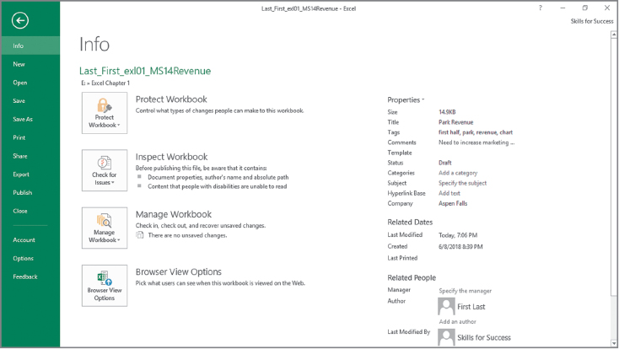
More Skills 14: Manage Document Properties
Notes:
Document properties are details about a file that describe or identify the file, include the author’s name, the title of the document, and keywords. In Backstage view, the right side of the Info page displays common document properties.

Slide 50
Summary
Create and Save Workbooks
Construct Formulas
Use AutoFill for Formulas and Data
Format and Edit a Worksheet, and Check Spelling
Insert Footers and Adjust Page Settings
Notes:
The skills and procedures you should have learned at the end of the chapter are:
Create and Save Workbooks
Enter Data and Merge and Center Titles
Construct Addition, Subtraction, Multiplication, and Division Formulas
Adjust Column Widths and Apply Cell Styles
Insert the SUM Function
AutoFill Formulas and Data
Format, Edit, and Check Spelling
Insert Footers and Adjust Page Settings
Display Formulas and Print Worksheets

Slide 51
Questions
Notes:
As you complete this introduction to Excel, be sure you ask questions. You want to understand the concepts so that you can continue to build on them in future chapters.

Slide 52

Copyright
All rights reserved. No part of this publication may be reproduced, stored in a retrieval system, or transmitted, in any form or by any means, electronic, mechanical, photocopying, recording, or otherwise, without the prior written permission of the publisher. Printed in the United States of America.

